Slide 1
Linear Regression

Slide 2
Machine learning algorithms
 | Supervised Learning | Unsupervised Learning
Discrete | Classification | Clustering
Continuous | Regression | Dimensionality reduction

Slide 3
Today’s plan: Linear Regression
Model representation
Cost function
Gradient descent
Features and polynomial regression

Slide 4
Linear Regression
Model representation
Cost
Gradient descent
Features and polynomial regression

Slide 5
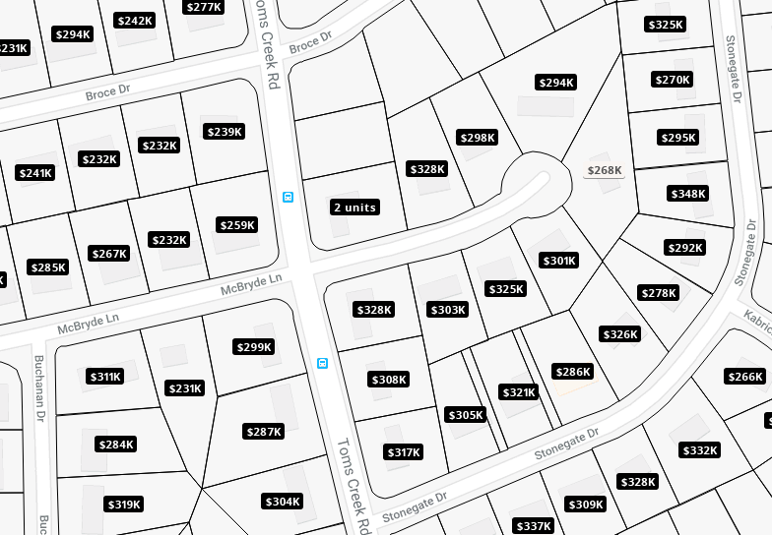

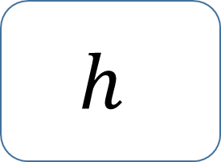
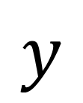
Regression
real-valued output
Training set
Learning Algorithm
$$h$$
$$x$$
$$y$$
Size of house
Hypothesis
Estimated price

Slide 6
House pricing prediction
Price ($) in 1000’s
400
300
200
100
500
1000
1500
2000
2500
Size in feet^2

Slide 7
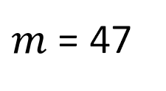


Training set
Size in feet^2 (x) | Price ($) in 1000’s (y)
2104 | 460
1416 | 232
1534 | 315
852 | 178
… | …
Notation:
$m$ = Number of training examples
$x$ = Input variable / features
$y$= Output variable / target variable
($x$, $y$) = One training example
($x^{(i)}$, $y^{(i)}$) = $i^{th}$training example
$m$ = 47
Examples:
$$x^{(1)}=2104$$
$$x^{(2)}=1416$$
$$y^{(1)}=460$$

Slide 8
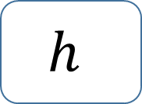



Model representation
$$y= h_{θ}\left(x\right)=θ_{0}+θ_{1}x$$
Shorthand$h\left(x\right)$
Training set
Learning Algorithm
Price ($) in 1000’s
400
300
$$x$$
$$h$$
$$y$$
200
100
Size of house
Hypothesis
Estimated price
500
1000
1500
2000
2500
Size in feet^2
Univariate linear regression

Slide 9
Linear Regression
Model representation
Cost function
Gradient descent
Features and polynomial regression

Slide 10
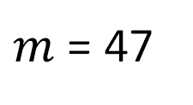
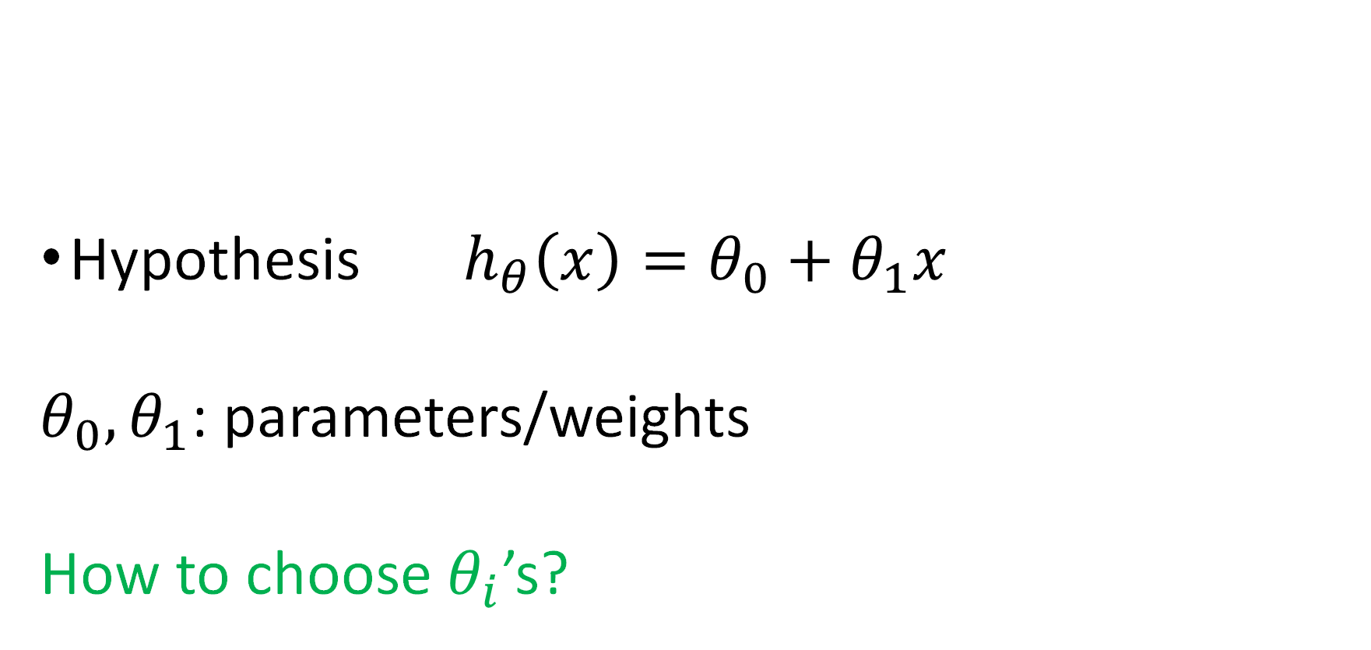
Training set
Size in feet^2 (x) | Price ($) in 1000’s (y)
2104 | 460
1416 | 232
1534 | 315
852 | 178
… | …
Hypothesis ${ h}_{θ}\left(x\right)=θ_{0}+θ_{1}x$
$θ_{0},θ_{1}$: parameters/weights
How to choose $θ_{i}$’s?
$m$ = 47

Slide 11

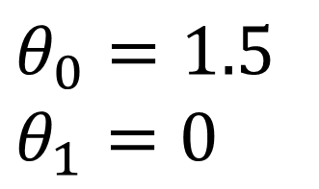




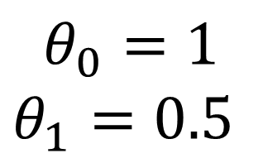

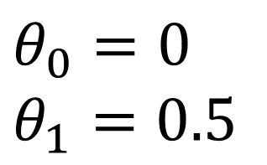

$$h_{θ}\left(x\right)=θ_{0}+θ_{1}x$$
$$y$$
$$y$$
$$y$$
3
3
3
2
2
2
1
1
1
1
2
3
$$x$$
1
2
3
$$x$$
1
2
3
$$x$$
$$θ_{0}=1.5$$
$$θ_{1}=0$$
$$θ_{0}=0$$
$$θ_{1}=0.5$$
$$θ_{0}=1$$
$$θ_{1}=0.5$$

Slide 12


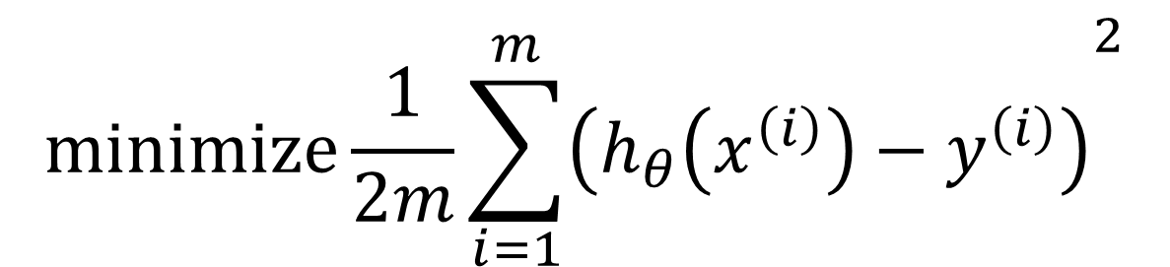

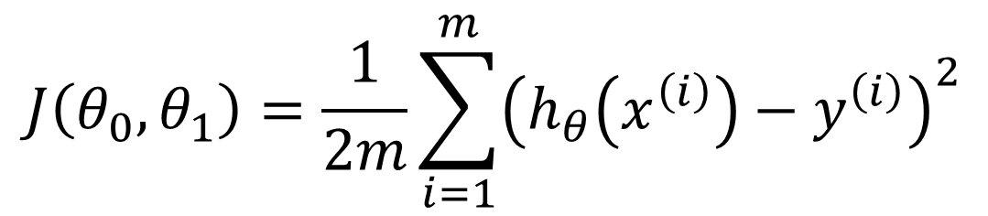
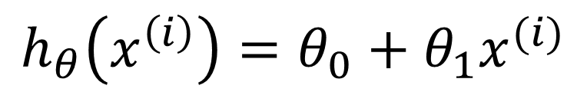


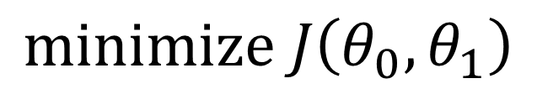
Cost function
$$minimize\frac{1}{2m}{\sum_{i=1}^{m}{\left(h_{θ}\left(x^{\left(i\right)}\right)−y^{\left(i\right)}\right)}}^{2}$$
$$θ_{0},θ_{1}$$
Idea: Choose $θ_{0},θ_{1}$ so that ${ h}_{θ}\left(x\right)$ is close to $y$ for our training example $(x,y)$
$$h_{θ}\left(x^{\left(i\right)}\right)=θ_{0}+θ_{1}x^{(i)}$$
$$J\left(θ_{0}, θ_{1}\right)=\frac{1}{2m}\sum_{i=1}^{m}{{\left(h_{θ}\left(x^{\left(i\right)}\right)−y^{\left(i\right)}\right)}^{2}}$$
$$y$$
Price ($) in 1000’s
400
300
200
100
$$minimize J\left(θ_{0}, θ_{1}\right)$$
Cost function
$$x$$
500
1000
1500
2000
2500
$$θ_{0},θ_{1}$$
Size in feet^2

Slide 13

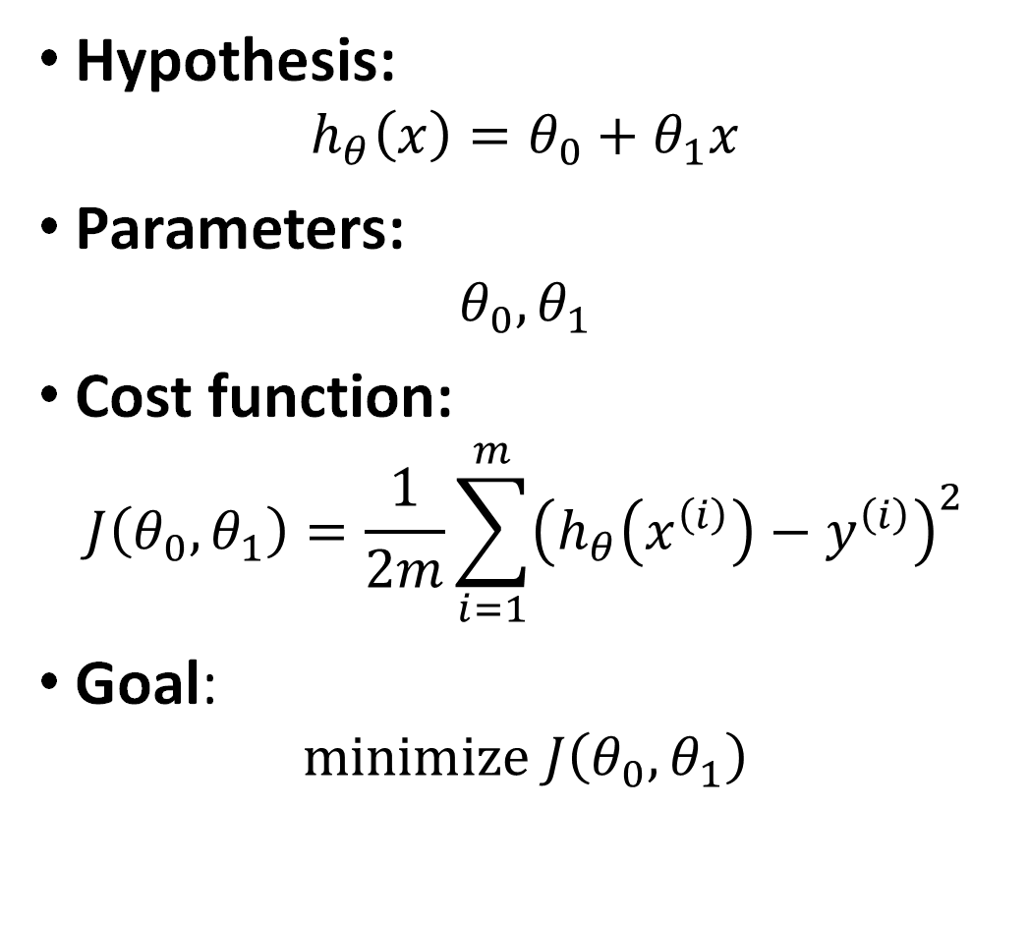

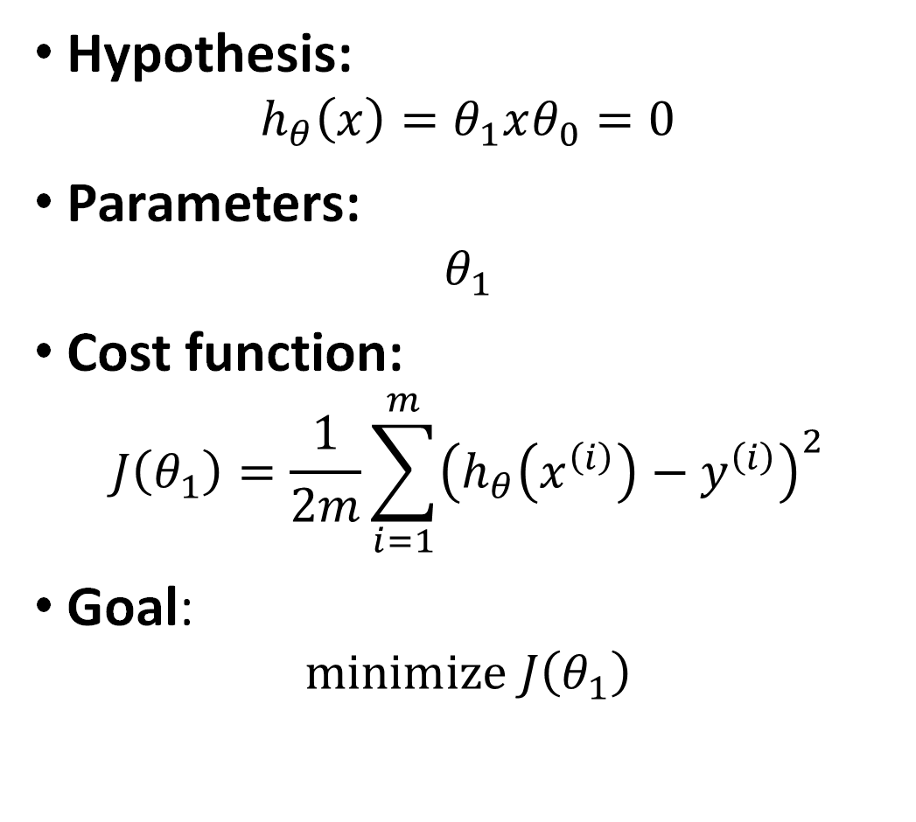
Simplified
Hypothesis:
$$h_{θ}\left(x\right)=θ_{0}+θ_{1}x$$
Parameters:
$$θ_{0},θ_{1}$$
Cost function:
$$J\left(θ_{0}, θ_{1}\right)=\frac{1}{2m}\sum_{i=1}^{m}{{\left(h_{θ}\left(x^{\left(i\right)}\right)−y^{\left(i\right)}\right)}^{2}}$$
Goal: $minimize J\left(θ_{0}, θ_{1}\right)$
Hypothesis:
$$h_{θ}\left(x\right)=θ_{1}xθ_{0}=0$$
Parameters:
$$θ_{1}$$
Cost function:
$$J\left(θ_{1}\right)=\frac{1}{2m}\sum_{i=1}^{m}{{\left(h_{θ}\left(x^{\left(i\right)}\right)−y^{\left(i\right)}\right)}^{2}}$$
Goal: $minimize J\left(θ_{1}\right)$
$$θ_{0},θ_{1}$$
$$θ_{0},θ_{1}$$

Slide 14

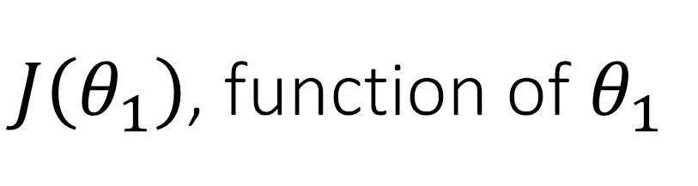
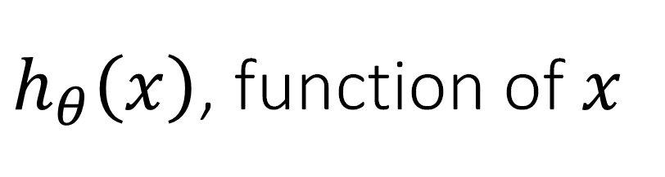



$h_{θ}\left(x\right)$, function of $x$
$J\left(θ_{1}\right)$, function of $θ_{1}$
$$y$$
$$J\left(θ_{1}\right)$$
3
3
2
2
1
1
$$x$$
$$θ_{1}$$
1
2
3
0
1
2
3

Slide 15
$h_{θ}\left(x\right)$, function of $x$
$J\left(θ_{1}\right)$, function of $θ_{1}$
$$y$$
$$J\left(θ_{1}\right)$$
3
3
2
2
1
1
$$x$$
$$θ_{1}$$
1
2
3
0
1
2
3

Slide 16
$h_{θ}\left(x\right)$, function of $x$
$J\left(θ_{1}\right)$, function of $θ_{1}$
$$y$$
$$J\left(θ_{1}\right)$$
3
3
2
2
1
1
$$x$$
$$θ_{1}$$
1
2
3
0
1
2
3

Slide 17
$h_{θ}\left(x\right)$, function of $x$
$J\left(θ_{1}\right)$, function of $θ_{1}$
$$y$$
$$J\left(θ_{1}\right)$$
3
3
2
2
1
1
$$x$$
$$θ_{1}$$
1
2
3
0
1
2
3

Slide 18
$h_{θ}\left(x\right)$, function of $x$
$J\left(θ_{1}\right)$, function of $θ_{1}$
$$y$$
$$J\left(θ_{1}\right)$$
3
3
2
2
1
1
$$x$$
$$θ_{1}$$
1
2
3
0
1
2
3

Slide 19
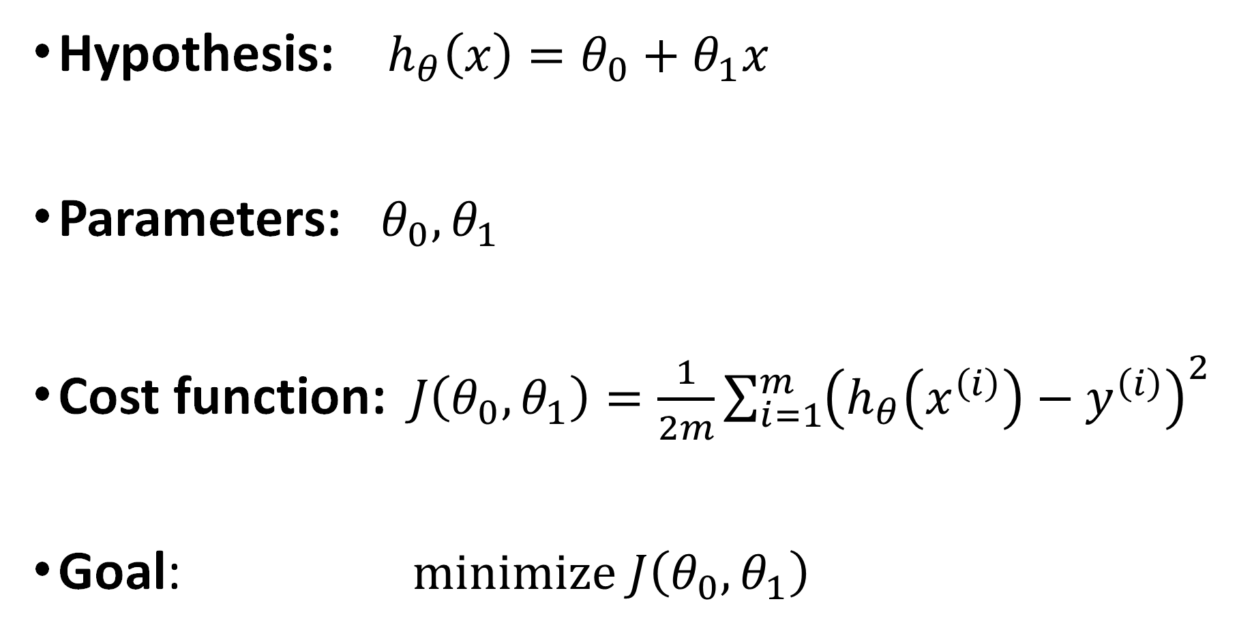
Hypothesis: $h_{θ}\left(x\right)=θ_{0}+θ_{1}x$
Parameters: $θ_{0},θ_{1}$
Cost function:$J\left(θ_{0}, θ_{1}\right)=\frac{1}{2m}\sum_{i=1}^{m}{{\left(h_{θ}\left(x^{\left(i\right)}\right)−y^{\left(i\right)}\right)}^{2}}$
Goal: $minimize J\left(θ_{0}, θ_{1}\right)$
$$θ_{0},θ_{1}$$

Slide 20
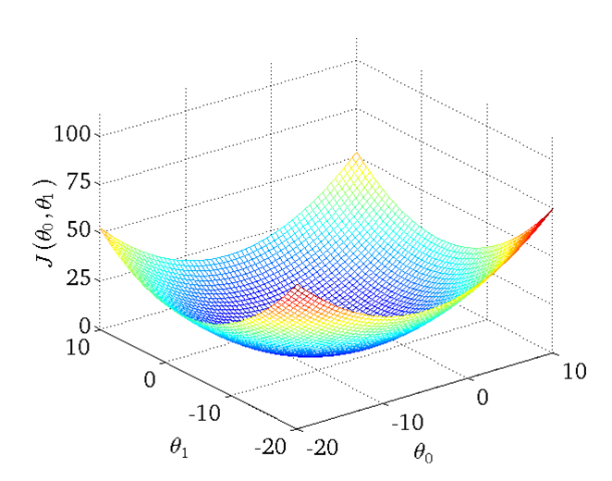
Cost function

Slide 21
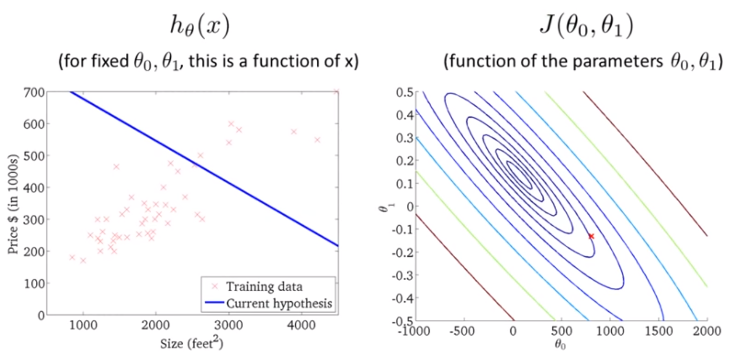
How do we find good $θ_{0},θ_{1}$ that minimize $J\left(θ_{0}, θ_{1}\right)$?

Slide 22
Linear Regression
Model representation
Cost function
Gradient descent
Features and polynomial regression

Slide 23

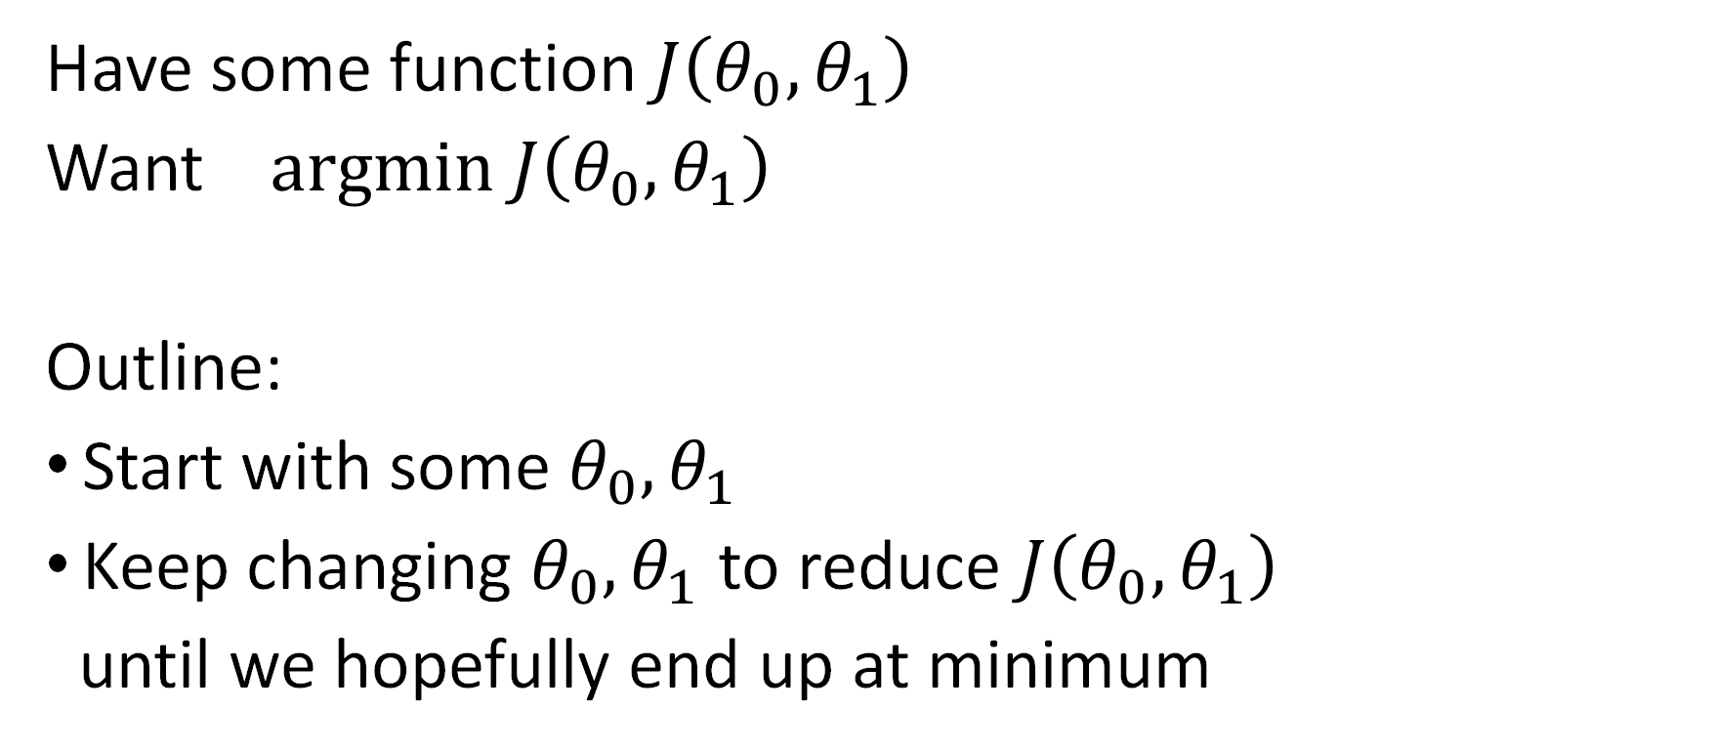
Gradient descent
Have some function $J\left(θ_{0}, θ_{1}\right)$
Want $argmin J\left(θ_{0}, θ_{1}\right)$
Outline:
Start with some $θ_{0}, θ_{1}$
Keep changing $θ_{0}, θ_{1}$ to reduce $J\left(θ_{0}, θ_{1}\right)$
until we hopefully end up at minimum
$$θ_{0},θ_{1}$$

Slide 24

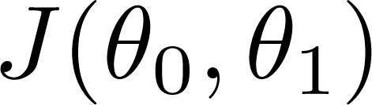




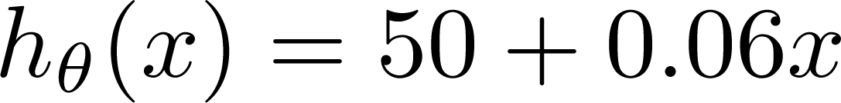
(for fixed , this is a function of x)
(function of the parameters )
Price ($)
in 1000’s
Size in feet² (x)

Slide 25
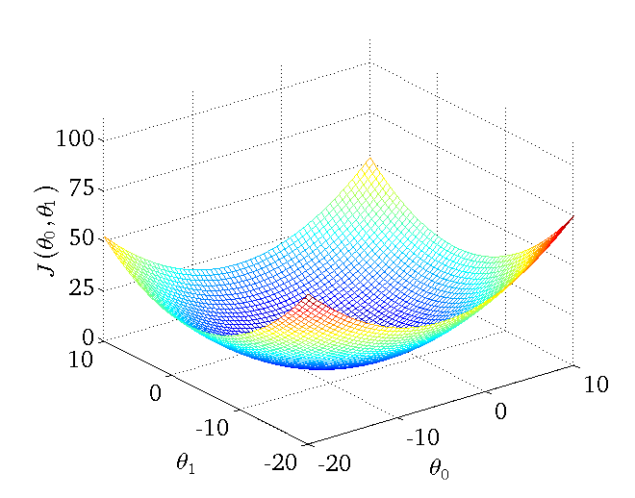

Slide 26
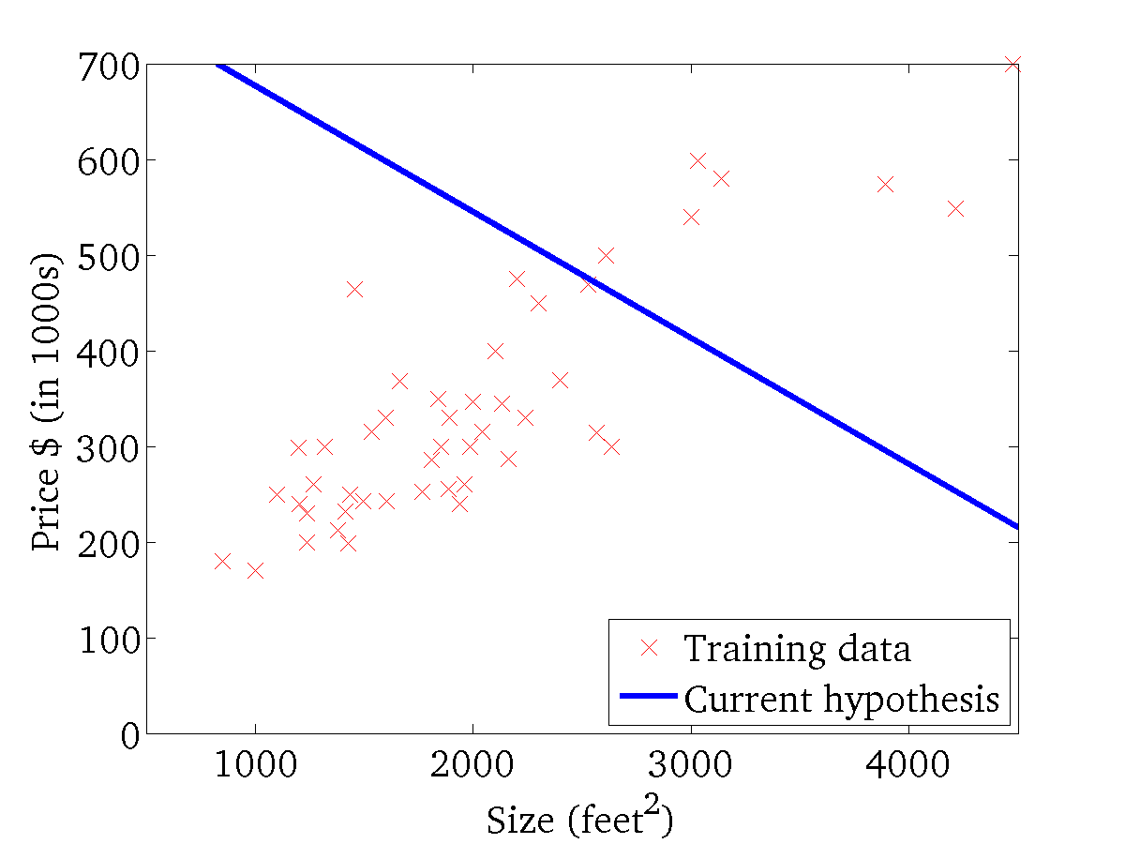
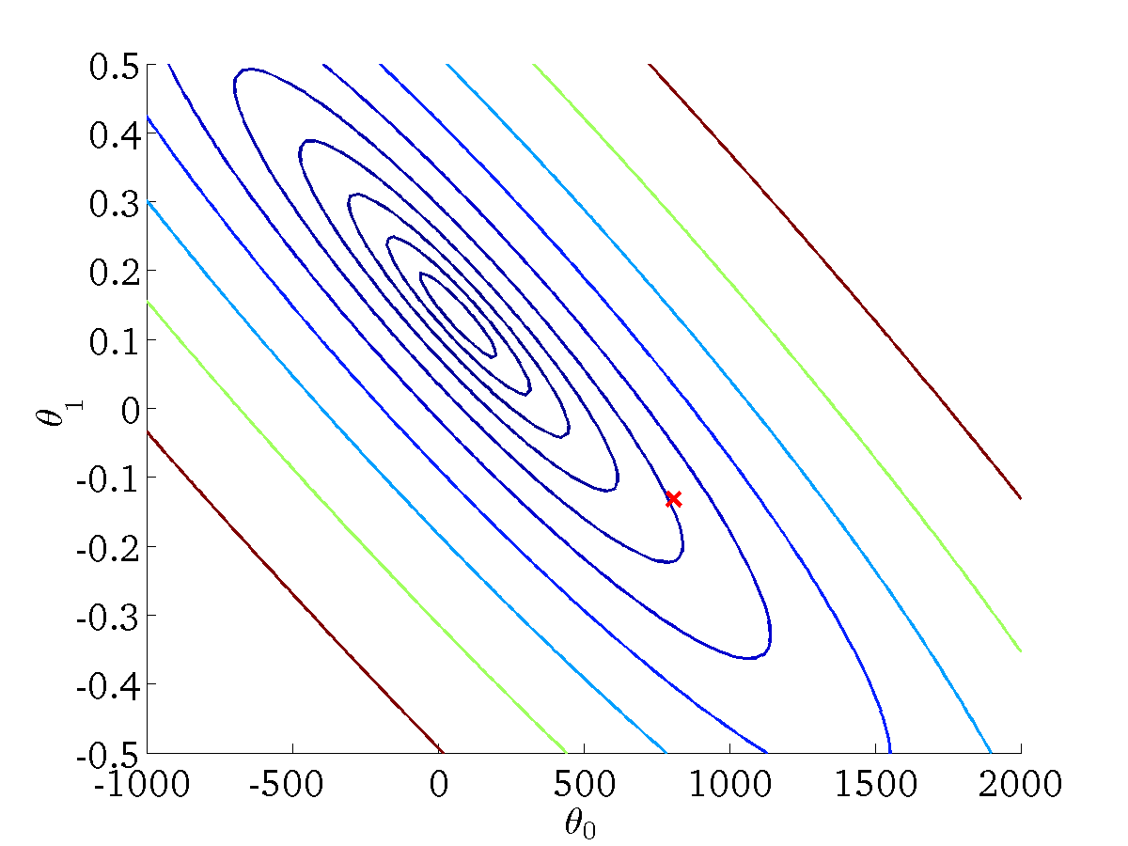
(for fixed , this is a function of x)
(function of the parameters )

Slide 27
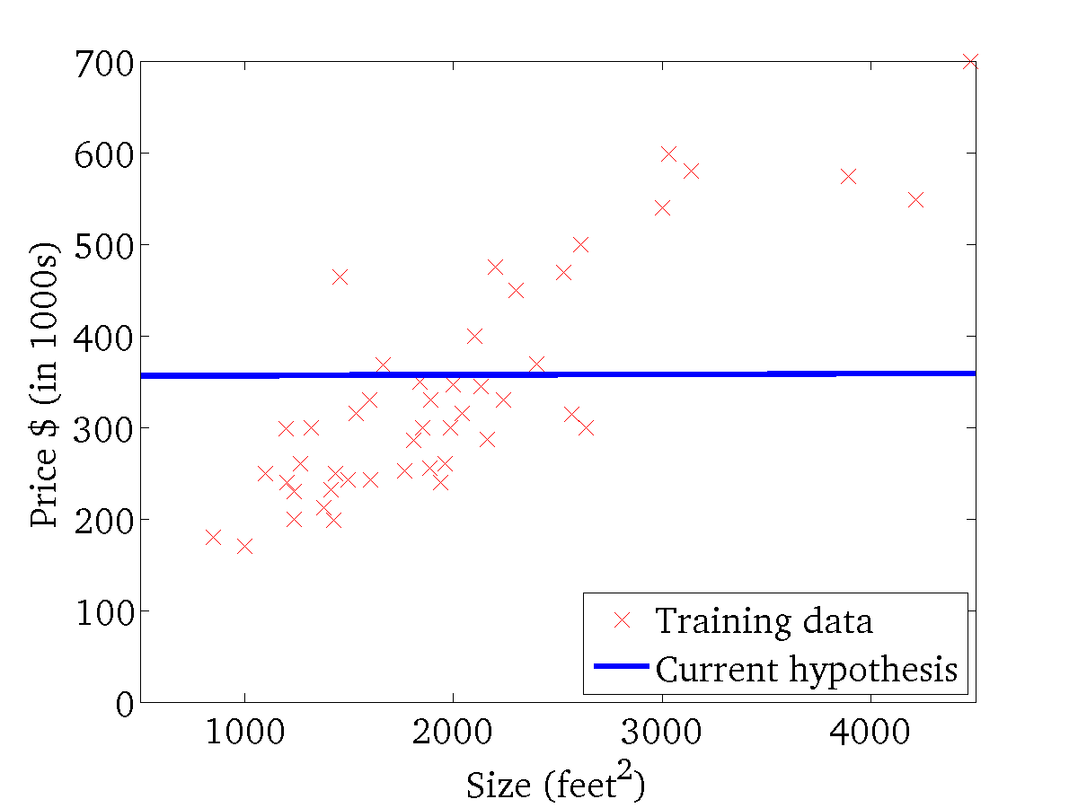
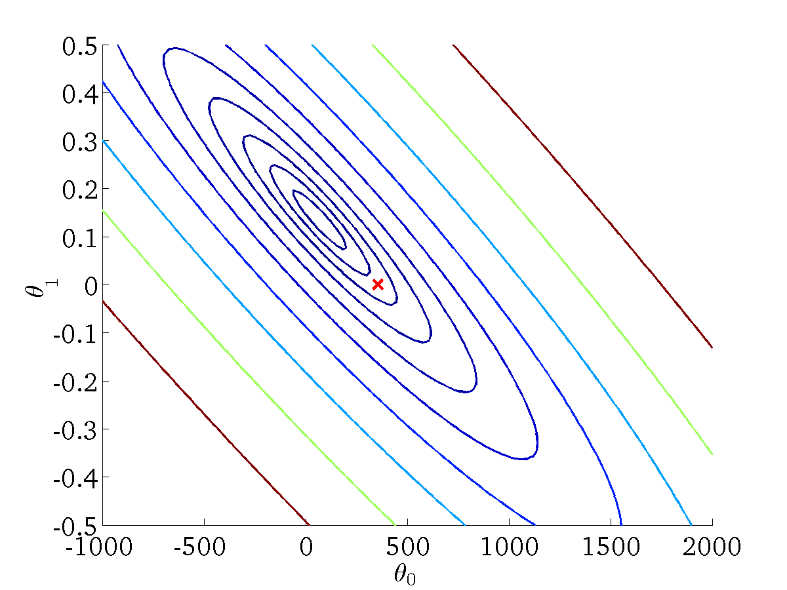
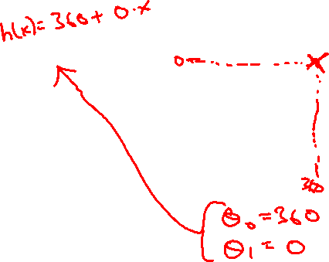
(for fixed , this is a function of x)
(function of the parameters )

Slide 28
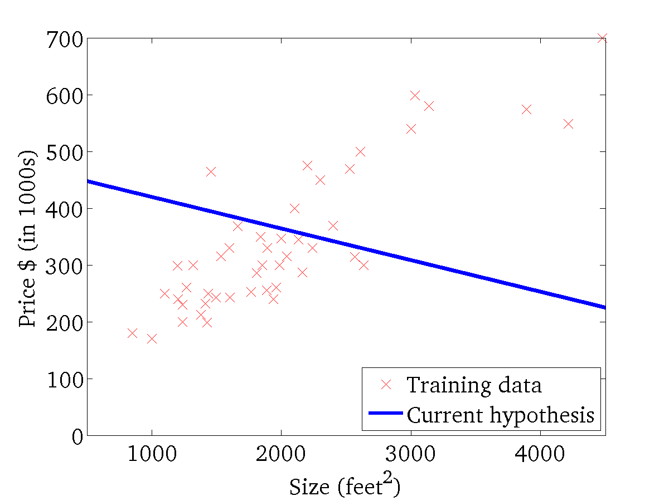

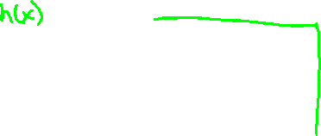
(for fixed , this is a function of x)
(function of the parameters )

Slide 29
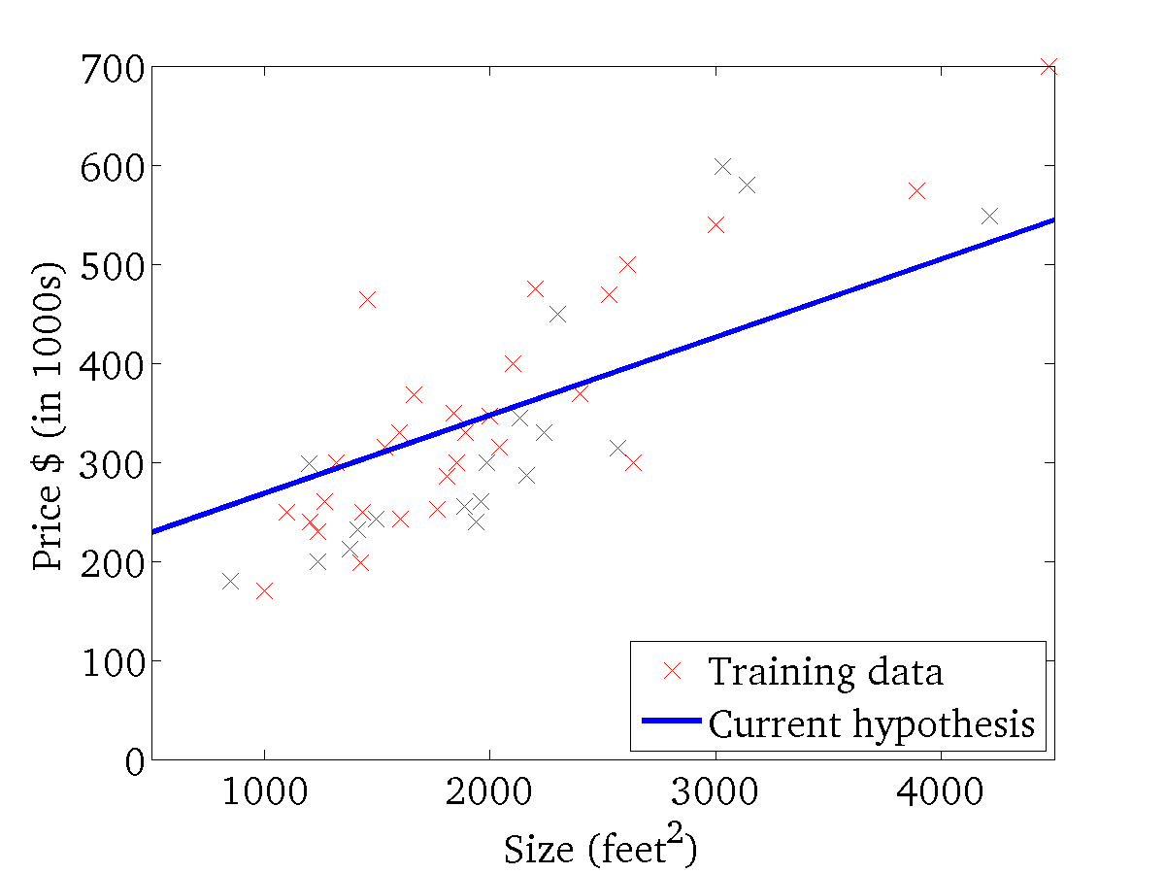
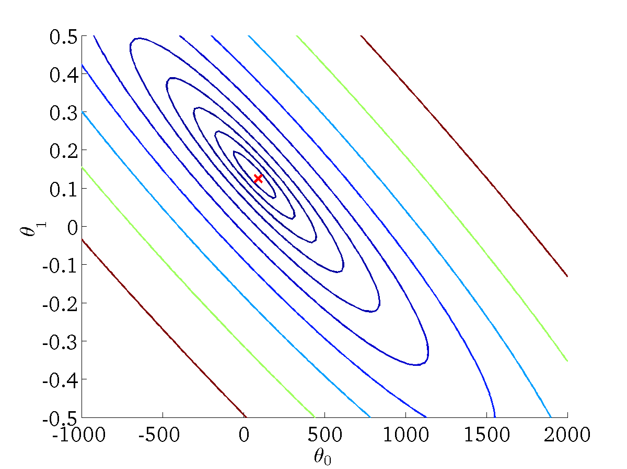
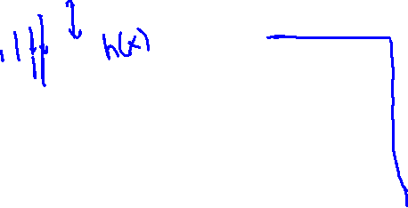
(for fixed , this is a function of x)
(function of the parameters )

Slide 30
Gradient descent
Linear regression with one variable

Slide 31
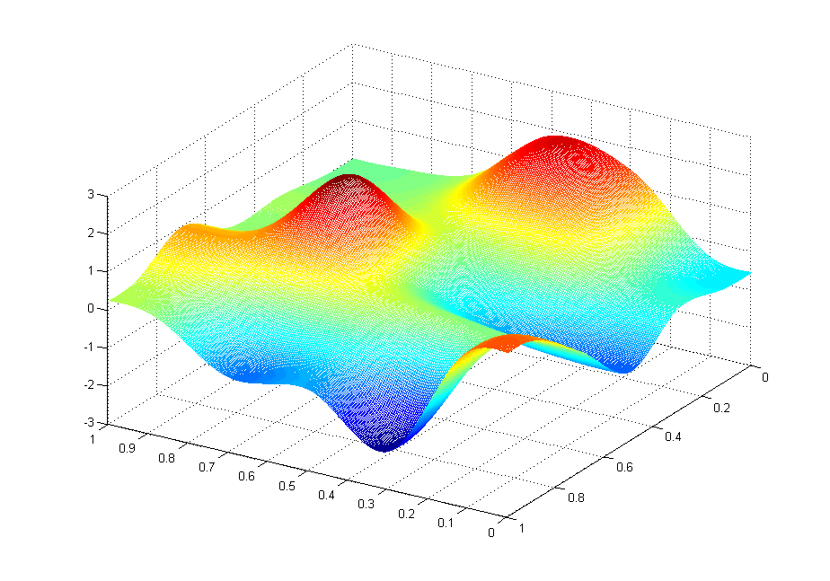
J(θ₀,θ₁)
θ₁
θ₀

Slide 32
J(θ₀,θ₁)
θ₁
θ₀

Slide 33
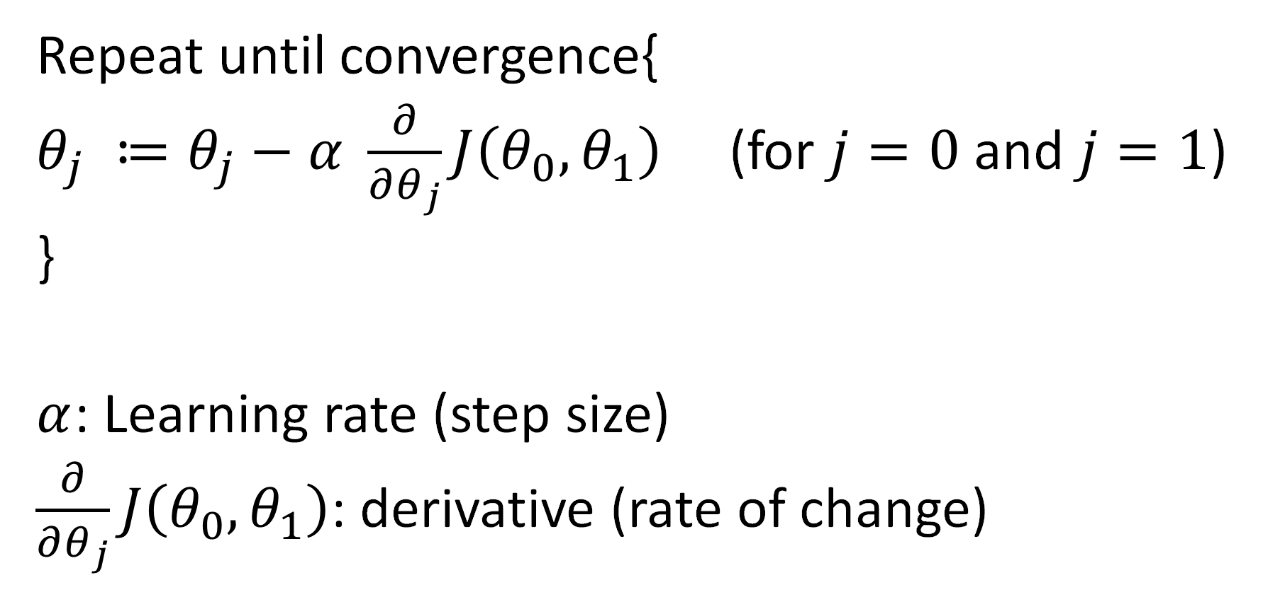
Gradient descent
Repeat until convergence{
$θ_{j} ≔θ_{j}−α \frac{∂}{∂θ_{j}}J\left(θ_{0}, θ_{1}\right)$ (for $j=0$ and $j=1$)
}
$α$: Learning rate (step size)
$\frac{∂}{∂θ_{j}}J\left(θ_{0}, θ_{1}\right)$: derivative (rate of change)

Slide 34
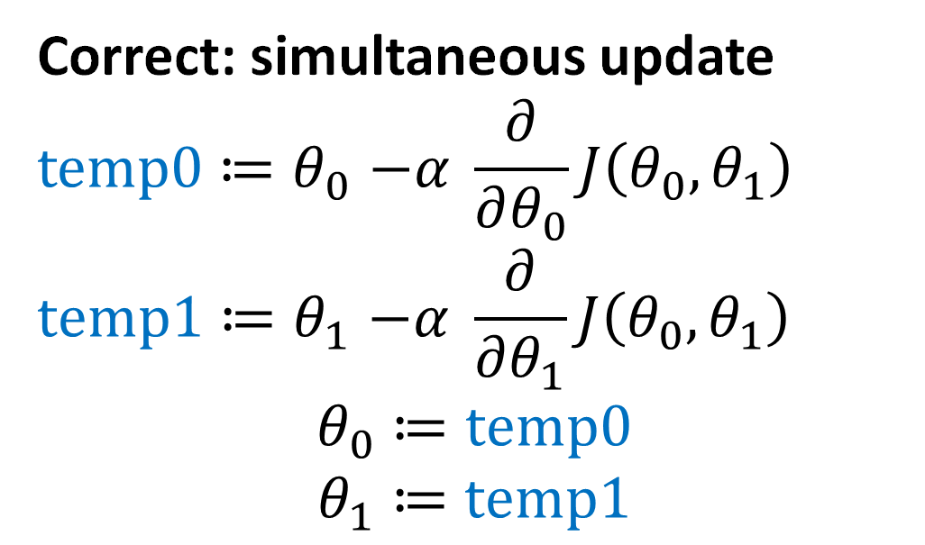
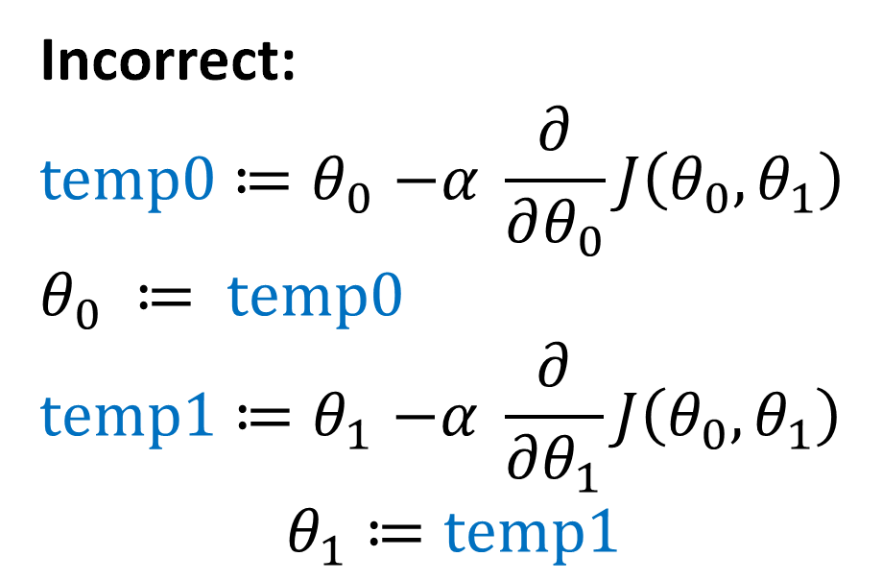
Gradient descent
Correct: simultaneous update
$$temp0{≔θ}_{0}−α \frac{∂}{∂θ_{0}}J\left(θ_{0}, θ_{1}\right)$$
$$temp1{≔θ}_{1}−α \frac{∂}{∂θ_{1}}J\left(θ_{0}, θ_{1}\right)$$
$$θ_{0}≔temp0$$
$$θ_{1}≔temp1$$
Incorrect:
$$temp0{≔θ}_{0}−α \frac{∂}{∂θ_{0}}J\left(θ_{0}, θ_{1}\right)$$
$$θ_{0} ≔ temp0$$
$$temp1{≔θ}_{1}−α \frac{∂}{∂θ_{1}}J\left(θ_{0}, θ_{1}\right)$$
$$θ_{1}≔temp1$$

Slide 35


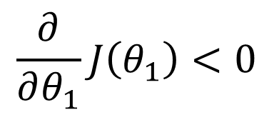
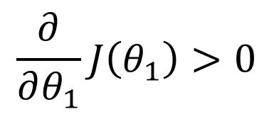

$$θ_{1} ≔θ_{1}−α \frac{∂}{∂θ_{1}}J\left(θ_{1}\right)$$
Negative slope
Positive slope
$$J\left(θ_{1}\right)$$
$$\frac{∂}{∂θ_{1}}J\left(θ_{1}\right)<0$$
3
$$\frac{∂}{∂θ_{1}}J\left(θ_{1}\right)>0$$
2
1
$$θ_{1}$$
0
1
2
3

Slide 36
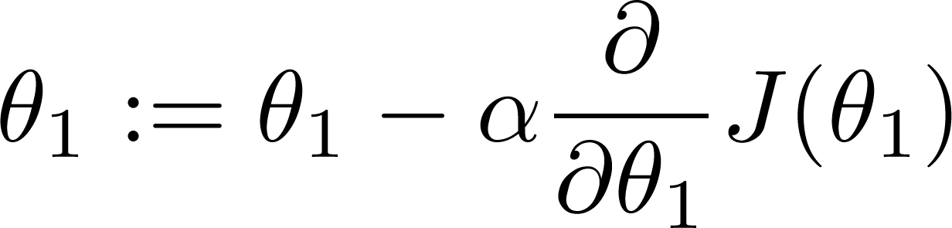
If α is too small, gradient descent can be slow.
If α is too large, gradient descent can overshoot the minimum. It may fail to converge, or even diverge.

Slide 37
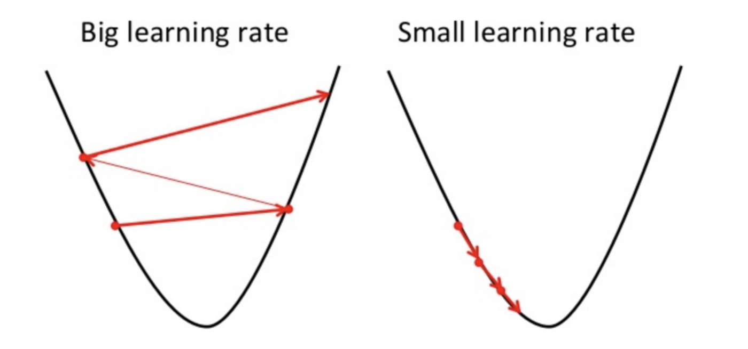
Learning rate

Slide 38

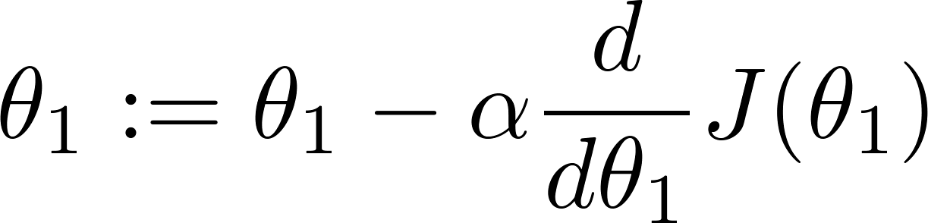
Slope = 0
at local optima
Current value of

Slide 39
Gradient descent can converge to a local minimum, even with the learning rate α fixed.
As we approach a local minimum, gradient descent will automatically take smaller steps. So, no need to decrease α over time.

Slide 40
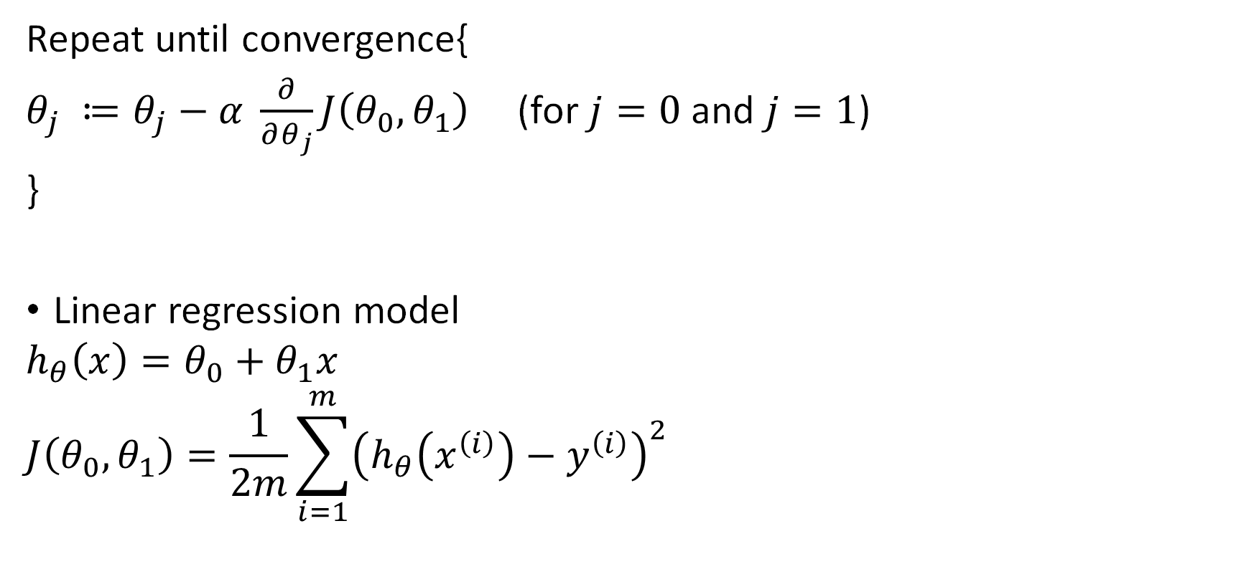
Gradient descent for linear regression
Repeat until convergence{
$θ_{j} ≔θ_{j}−α \frac{∂}{∂θ_{j}}J\left(θ_{0}, θ_{1}\right)$ (for $j=0$ and $j=1$)
}
Linear regression model
$$h_{θ}\left(x\right)=θ_{0}+θ_{1}x$$
$$J\left(θ_{0}, θ_{1}\right)=\frac{1}{2m}\sum_{i=1}^{m}{{\left(h_{θ}\left(x^{\left(i\right)}\right)−y^{\left(i\right)}\right)}^{2}}$$

Slide 41
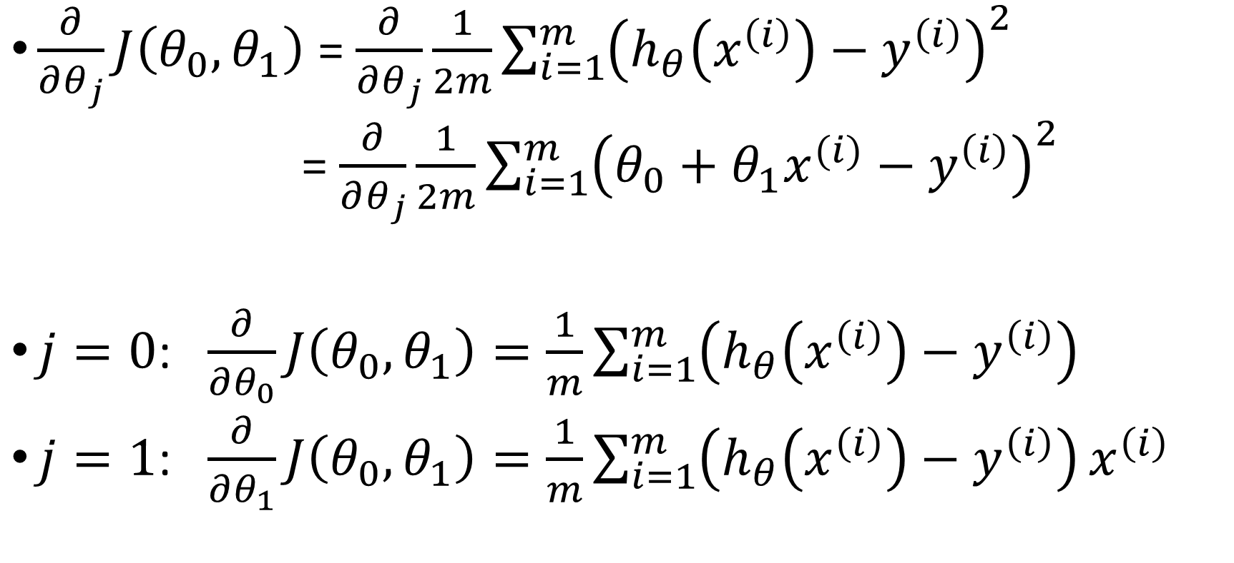
Computing partial derivative
$\frac{∂}{∂θ_{j}}J\left(θ_{0}, θ_{1}\right)$ = $\frac{∂}{∂θ_{j}}\frac{1}{2m}\sum_{i=1}^{m}{{\left(h_{θ}\left(x^{\left(i\right)}\right)−y^{\left(i\right)}\right)}^{2}}$
= $\frac{∂}{∂θ_{j}}\frac{1}{2m}\sum_{i=1}^{m}{{\left(θ_{0}+θ_{1}x^{(i)}−y^{\left(i\right)}\right)}^{2}}$
$j=0$: $\frac{∂}{∂θ_{0}}J\left(θ_{0}, θ_{1}\right)=\frac{1}{m}\sum_{i=1}^{m}{\left(h_{θ}\left(x^{\left(i\right)}\right)−y^{\left(i\right)}\right)}$
$j=1$: $\frac{∂}{∂θ_{1}}J\left(θ_{0}, θ_{1}\right)=\frac{1}{m}\sum_{i=1}^{m}{\left(h_{θ}\left(x^{\left(i\right)}\right)−y^{\left(i\right)}\right)}x^{\left(i\right)}$

Slide 42

Gradient descent for linear regression
Repeat until convergence{
$$θ_{0} ≔θ_{0}−α\frac{1}{m}\sum_{i=1}^{m}{\left(h_{θ}\left(x^{\left(i\right)}\right)−y^{\left(i\right)}\right)}$$
$$θ_{1} ≔θ_{1}−α\frac{1}{m}\sum_{i=1}^{m}{\left(h_{θ}\left(x^{\left(i\right)}\right)−y^{\left(i\right)}\right)}x^{\left(i\right)}$$
}
Update $θ_{0}$ and $θ_{1}$ simultaneously

Slide 43


Batch gradient descent
“Batch”: Each step of gradient descent uses all the training examples
Repeat until convergence{
$$θ_{0} ≔θ_{0}−α\frac{1}{m}\sum_{i=1}^{m}{\left(h_{θ}\left(x^{\left(i\right)}\right)−y^{\left(i\right)}\right)}$$
$$θ_{1} ≔θ_{1}−α\frac{1}{m}\sum_{i=1}^{m}{\left(h_{θ}\left(x^{\left(i\right)}\right)−y^{\left(i\right)}\right)}x^{\left(i\right)}$$
}
$m$: Number of training examples

Slide 44
Linear Regression
Model representation
Cost function
Gradient descent
Features and polynomial regression

Slide 45

Training dataset
Size in feet^2 (x) | Price ($) in 1000’s (y)
2104 | 460
1416 | 232
1534 | 315
852 | 178
… | …
$$h_{θ}\left(x\right)=θ_{0}+θ_{1}x$$

Slide 46



Multiple features (input variables)
Size in feet^2 ($x_{1}$) | Number of bedrooms ($x_{2}$) | Number of floors ($x_{3}$) | Age of home (years) ($x_{4}$) | Price ($) in 1000’s (y)
2104 | 5 | 1 | 45 | 460
1416 | 3 | 2 | 40 | 232
1534 | 3 | 2 | 30 | 315
852 | 2 | 1 | 36 | 178
… |  |  |  | …
Notation:
$n$ = Number of features
$x^{(i)}$= Input features of $i^{th}$training example
$x_{j}^{(i)}$= Value of feature $j$ in $i^{th}$training example
$$x_{3}^{(2)}=?$$
$$x_{3}^{(4)}=?$$

Slide 47

Hypothesis
Previously: $h_{θ}\left(x\right)=θ_{0}+θ_{1}x$
Now: $h_{θ}\left(x\right)=θ_{0}+θ_{1}x_{1}+θ_{2}x_{2}{+θ}_{3}x_{3}+θ_{4}x_{4}$

Slide 48


$$h_{θ}\left(x\right)=θ_{0}+θ_{1}x_{1}+θ_{2}x_{2}+…+θ_{n}x_{n}$$
For convenience of notation, define $x_{0}=1$ ($x_{0}^{(i)}=1$for all examples)
$x=\left[\begin{aligned}x_{0} \\ x_{1} \\ x_{2} \\ ⋮ \\ x_{n}\end{aligned}\right]∈R^{n+1} θ=\left[\begin{aligned}θ_{0} \\ θ_{1} \\ θ_{2} \\ ⋮ \\ θ_{n}\end{aligned}\right]∈R^{n+1}$
$h_{θ}\left(x\right)=θ_{0}+θ_{1}x_{1}+θ_{2}x_{2}+…+θ_{n}x_{n}$
$$=θ^{⊤}x$$

Slide 49


Gradient descent
Previously ($n=1$)
Repeat until convergence{
$$θ_{0} ≔θ_{0}−α\frac{1}{m}\sum_{i=1}^{m}{\left(h_{θ}\left(x^{\left(i\right)}\right)−y^{\left(i\right)}\right)}$$
$$θ_{1} ≔θ_{1}−α\frac{1}{m}\sum_{i=1}^{m}{\left(h_{θ}\left(x^{\left(i\right)}\right)−y^{\left(i\right)}\right)}x^{\left(i\right)}$$
}
New algorithm ($n≥1$)
Repeat until convergence{
$$θ_{j} ≔θ_{j}−α\frac{1}{m}\sum_{i=1}^{m}{\left(h_{θ}\left(x^{\left(i\right)}\right)−y^{\left(i\right)}\right)}x_{j}^{\left(i\right)}$$
}
Simultaneously update
$$θ_{j}, for j=0, 1, ⋯,n$$

Slide 50





Gradient descent in practice: Feature scaling
Idea: Make sure features are on a similar scale (e.g,. ${−1≤x}_{i}≤1$)
E.g. $x_{1}=$ size (0-2000 feat^2)
${ x}_{2} =$ number of bedrooms (1-5)
$$θ_{2}$$
$$θ_{2}$$
3
3
2
2
1
1
$$θ_{1}$$
0
1
2
3
$$θ_{1}$$
0
1
2
3

Slide 51


Gradient descent in practice: Learning rate
Automatic convergence test
$α$ too small: slow convergence
$α$ too large: may not converge
To choose $α$, try
0.001, … 0.01, …, 0.1, … , 1

Slide 52


House prices prediction
$h_{θ}\left(x\right)=θ_{0}+θ_{1}×frontage+θ_{2}×depth$
Area $x= frontage×depth$
$h_{θ}\left(x\right)=θ_{0}+θ_{1}x$

Slide 53


Polynomial regression
$h_{θ}\left(x\right)=θ_{0}+θ_{1}x_{1}+θ_{2}x_{2}+θ_{3}x_{3}$
$$=θ_{0}+θ_{1}\left(size\right)+θ_{2}{\left(size\right)}^{2}+θ_{3}{\left(size\right)}^{3}$$
Price ($) in 1000’s
400
300
200
$x_{1}$ = (size)
$x_{2}$ = (size)^2
$x_{3}$ = (size)^3
100
500
1000
1500
2000
2500
Size in feet^2

Slide 54
Choice of features
Price
(y)
Size (x)

